Slide 1
Round Lake Area B.E.S.T. Bringing Everyone’s Strengths Together
Community Empowerment Grant
Annual Breakfast
5/10/18

Slide 2
Round Lake Area B.E.S.T.
Bringing Everyone's Strengths Together
creating some of ”THE BEST” Lake County Has to Offer
In March of 2009 Round Lake Area B.E.S.T. started our Community Empowerment Grants. The grants are designed as mini-grants for community groups, student groups, non-profit organizations, and/or individuals who have a sustainable project/program, etc. which enriches the lives of youth, families and/or the community and incorporates the six pillars of CHARACTER COUNTS

Slide 3
Round Lake Area B.E.S.T.
Bringing Everyone's Strengths Together
creating some of ”THE BEST” Lake County Has to Offer
Six Pillars of Character Counts
Trustworthiness, Responsibility,
Caring, Respect,
Fairness, Citizenship

Slide 4
Round Lake Area B.E.S.T.
Bringing Everyone's Strengths Together
creating some of ”THE BEST” Lake County Has to Offer
Today we are here to celebrate the accomplishment of the
2017 Empowerment Grant Recipients.
Village Elementary School
Round Lake Area Early Education Center
Calvary Presbyterian Church and University of Illinois Extension
WRLR
Round Lake Beach Cultural and Civic Center Arts Foundation
Round Lake Area Garden Club
John T. Magee Middle School

Slide 5
Village Elementary School
Lightbox
Susan Gaylor
Library Media Assistant
Andrew Wilson, Principal

Slide 6
Why We Love Lightbox
On line books available in both English and Spanish
Accessible from any device – home, school, public library
INTERACTIVE
Accommodates the learning styles of all students
Provides choices
Builds background knowledge
Teaches new vocabulary “painlessly”
Extends learning through websites that have been vetted for content

Slide 7
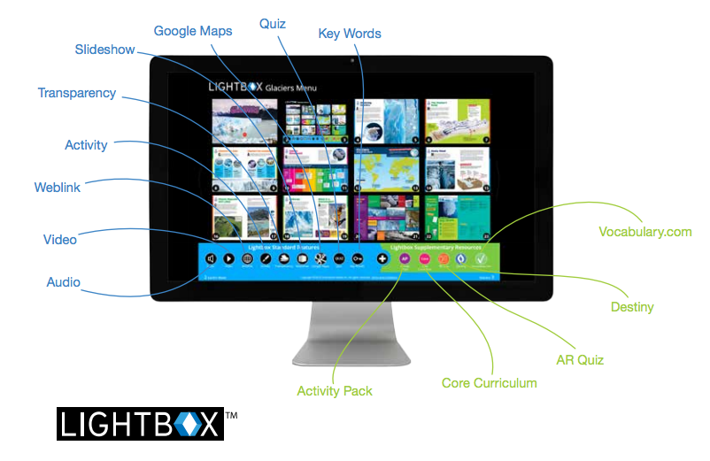

Slide 8
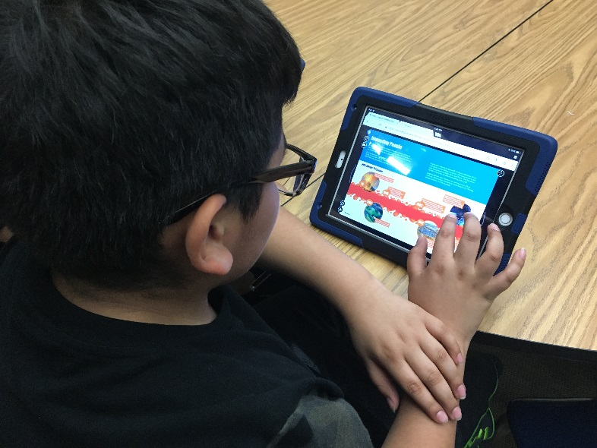
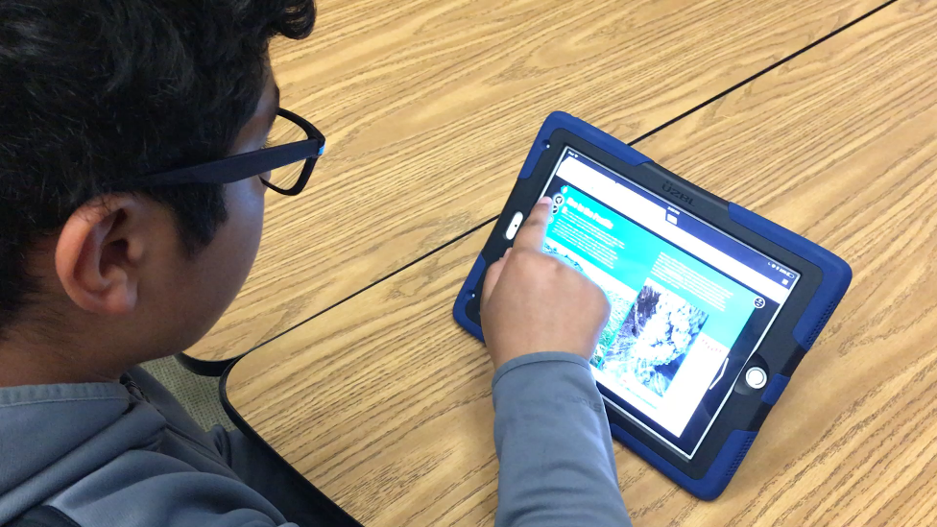
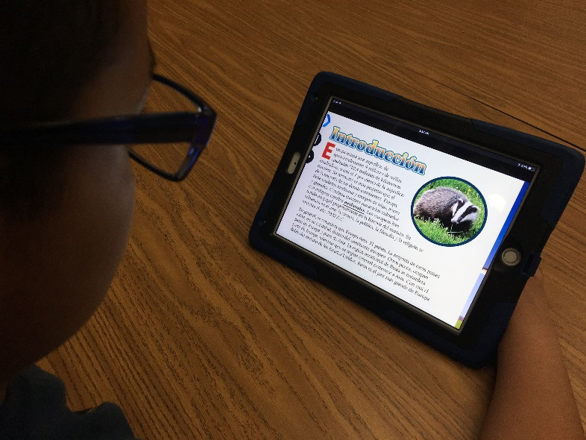
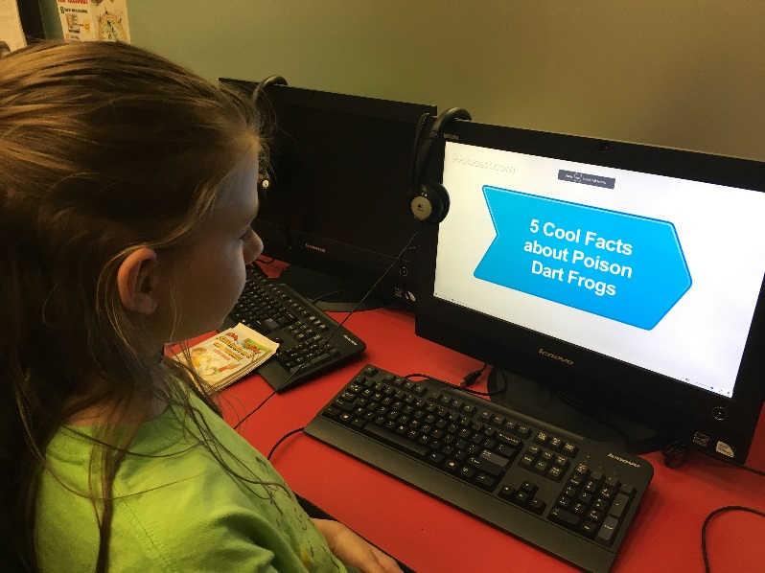
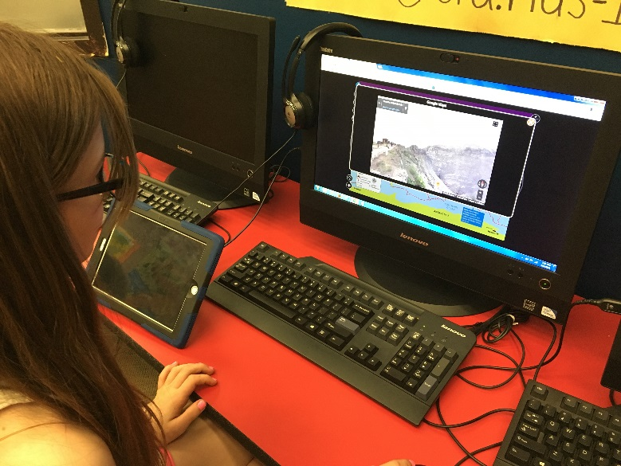
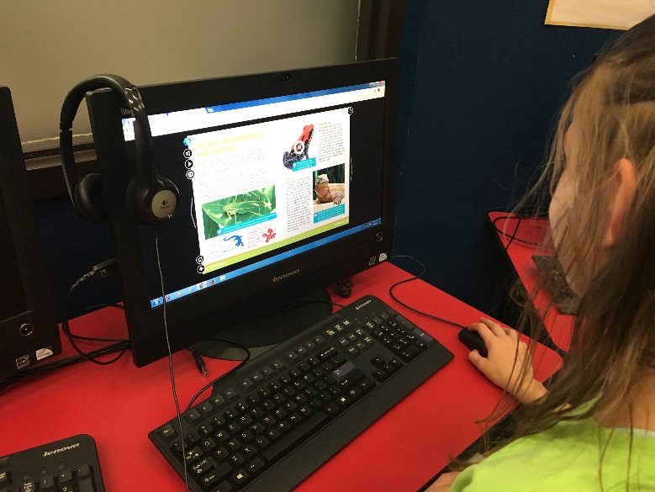

Slide 9
Round Lake Area Schools
Early Education Center
School Garden
Kali Skiles, Teacher
Janie Metzger, Principal

Slide 10
EEC Garden
Now:
6 raised beds
Planted several varieties of plants
Tomatoes, cucumbers, onions, carrots, cabbage, kale, zucchini
Coming soon:
Increase the amount of families involved
Summer story time
Expand harvest
Plants from University of Illinois Lake County Extension
Install small fence around the garden

Slide 11
EEC Garden: Impact of Garden:
Families became more engaged
Over ten families have volunteered
Most families who volunteer once have returned to volunteer again
Students are learning about nutrition
At the start of the garden unit only 17% of students could properly identify healthy and “sometimes” foods
After the garden unit 87% of students could identify healthy and “sometimes” foods with 80% accuracy
Students are meeting state standards by working in the garden
Show an awareness of changes that occur in oneself and the environment
Describe and compare basic needs of living things
Participate in discussions about simple ways to take care of the environment

Slide 12
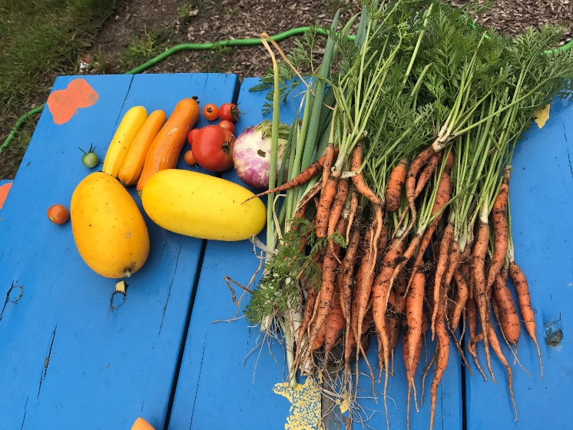
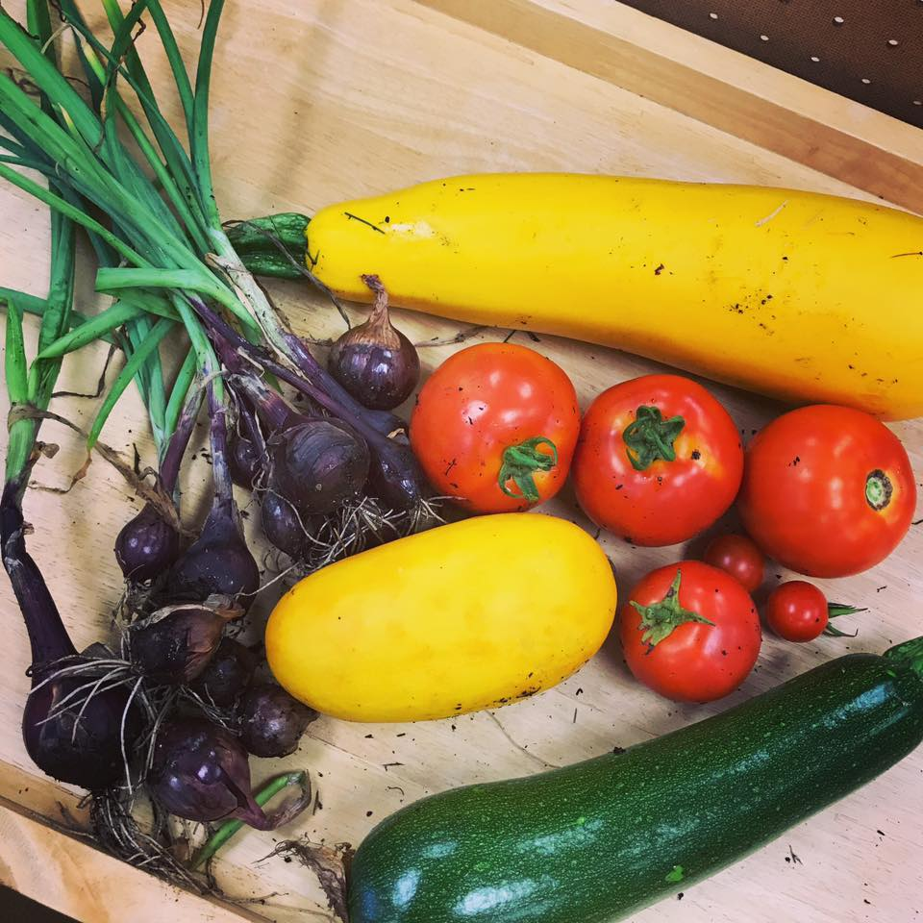
Round Lake Early Education Center Garden

Slide 13
Calvary Presbyterian Church
and
University of Illinois Extension
Summer Learn and Grow
Mary Cate Pelser and Dale Kehr

Slide 14
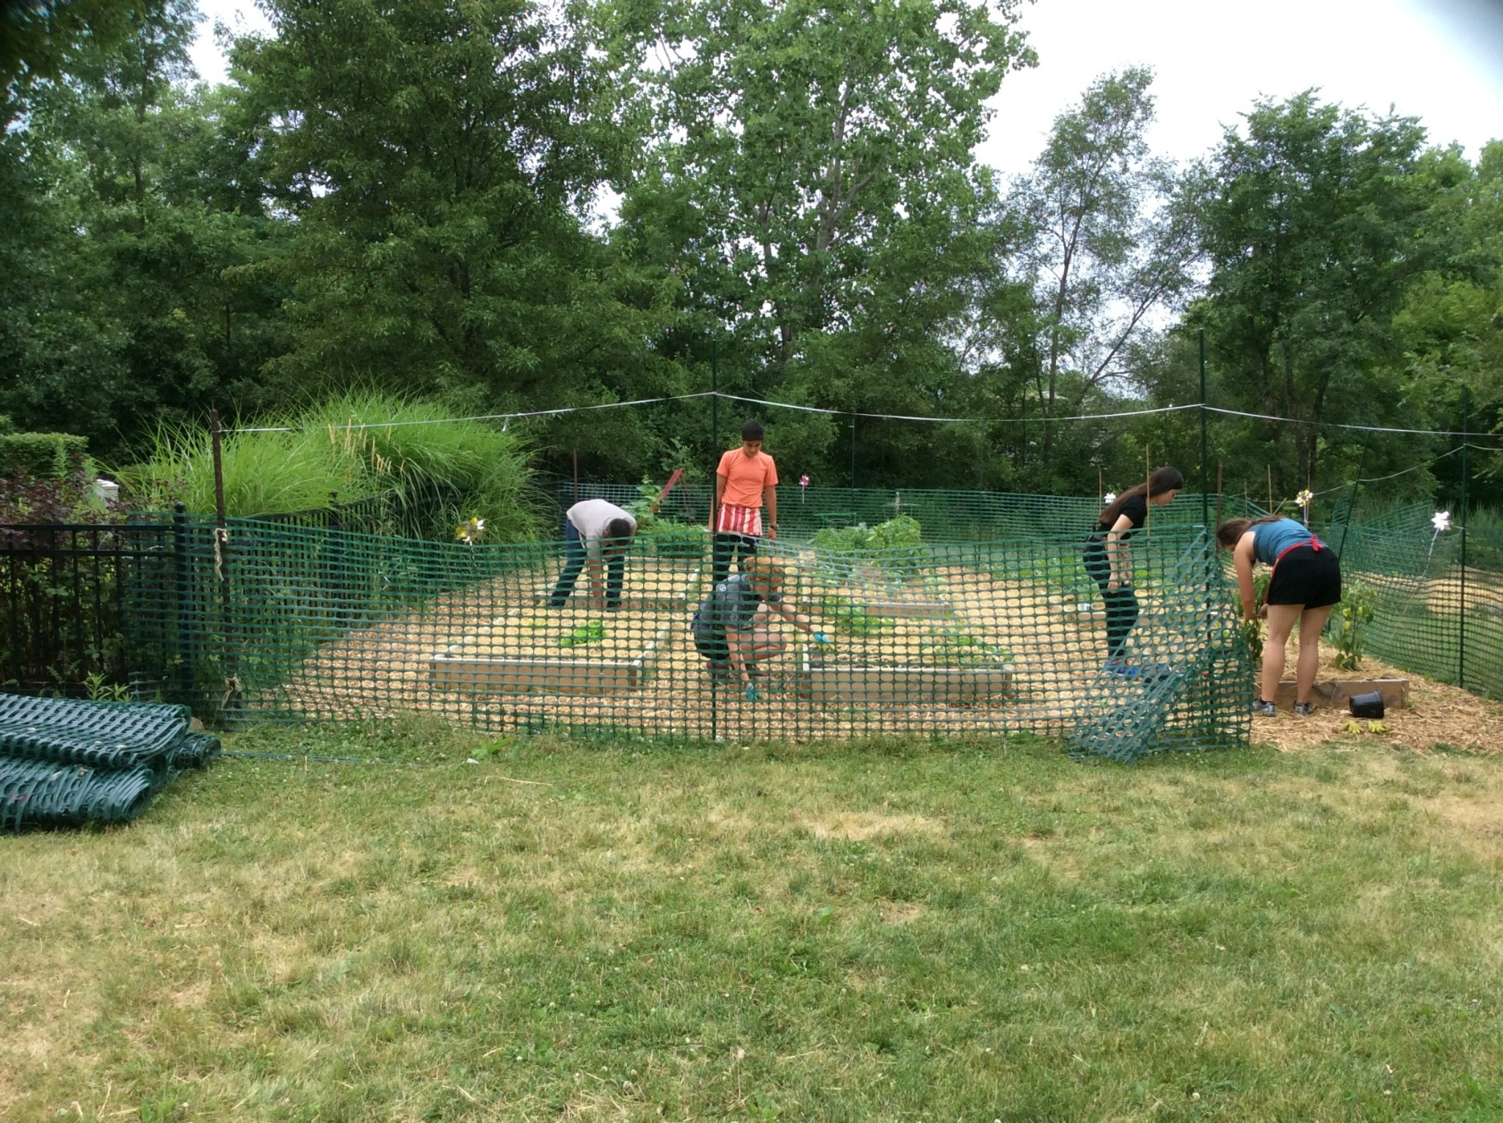
The Need For a Fence
Animals ate the produce
Deer
Rabbits
Moles
And more

Slide 15
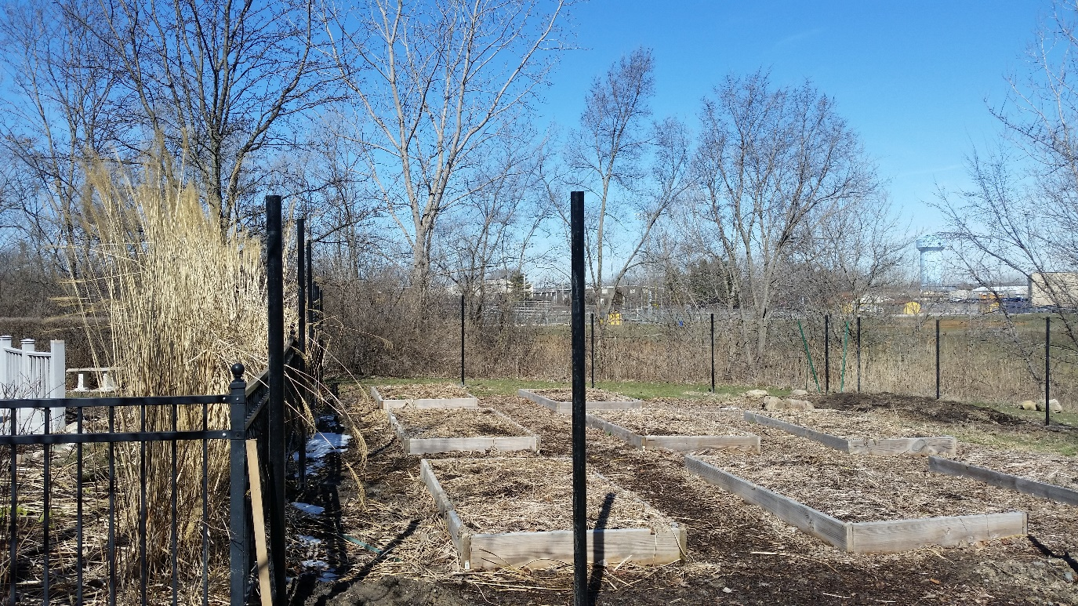
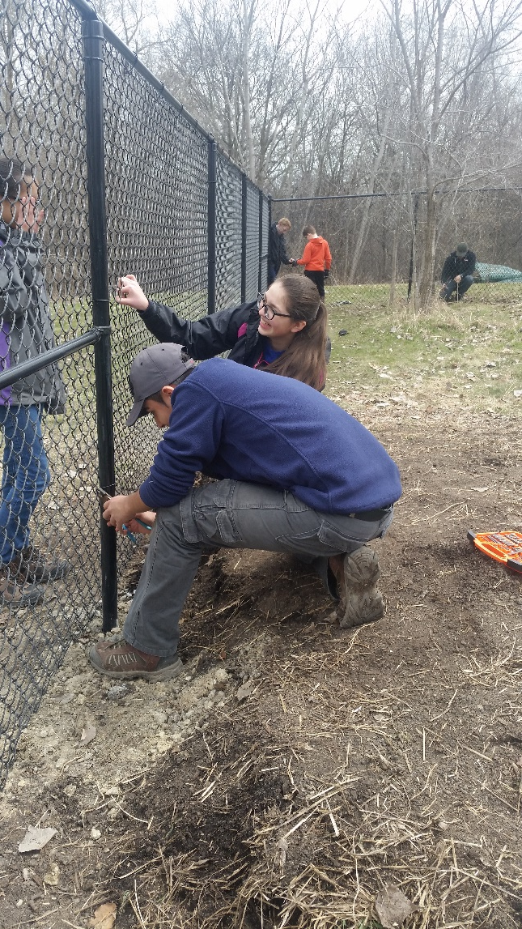
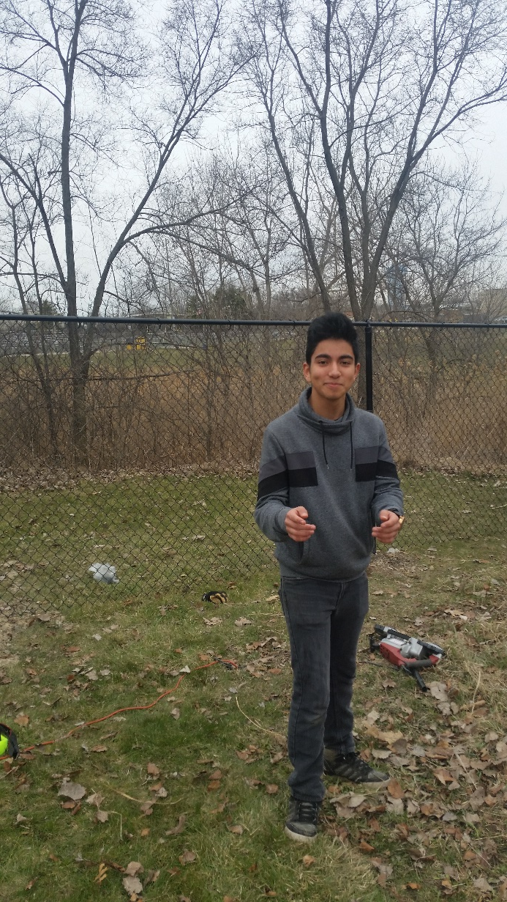
Eagle Scout
Jesus and former SLG
Wanting to make this into a community focus. Shared and got input from the youth about the fence and the $500 donation

Slide 16
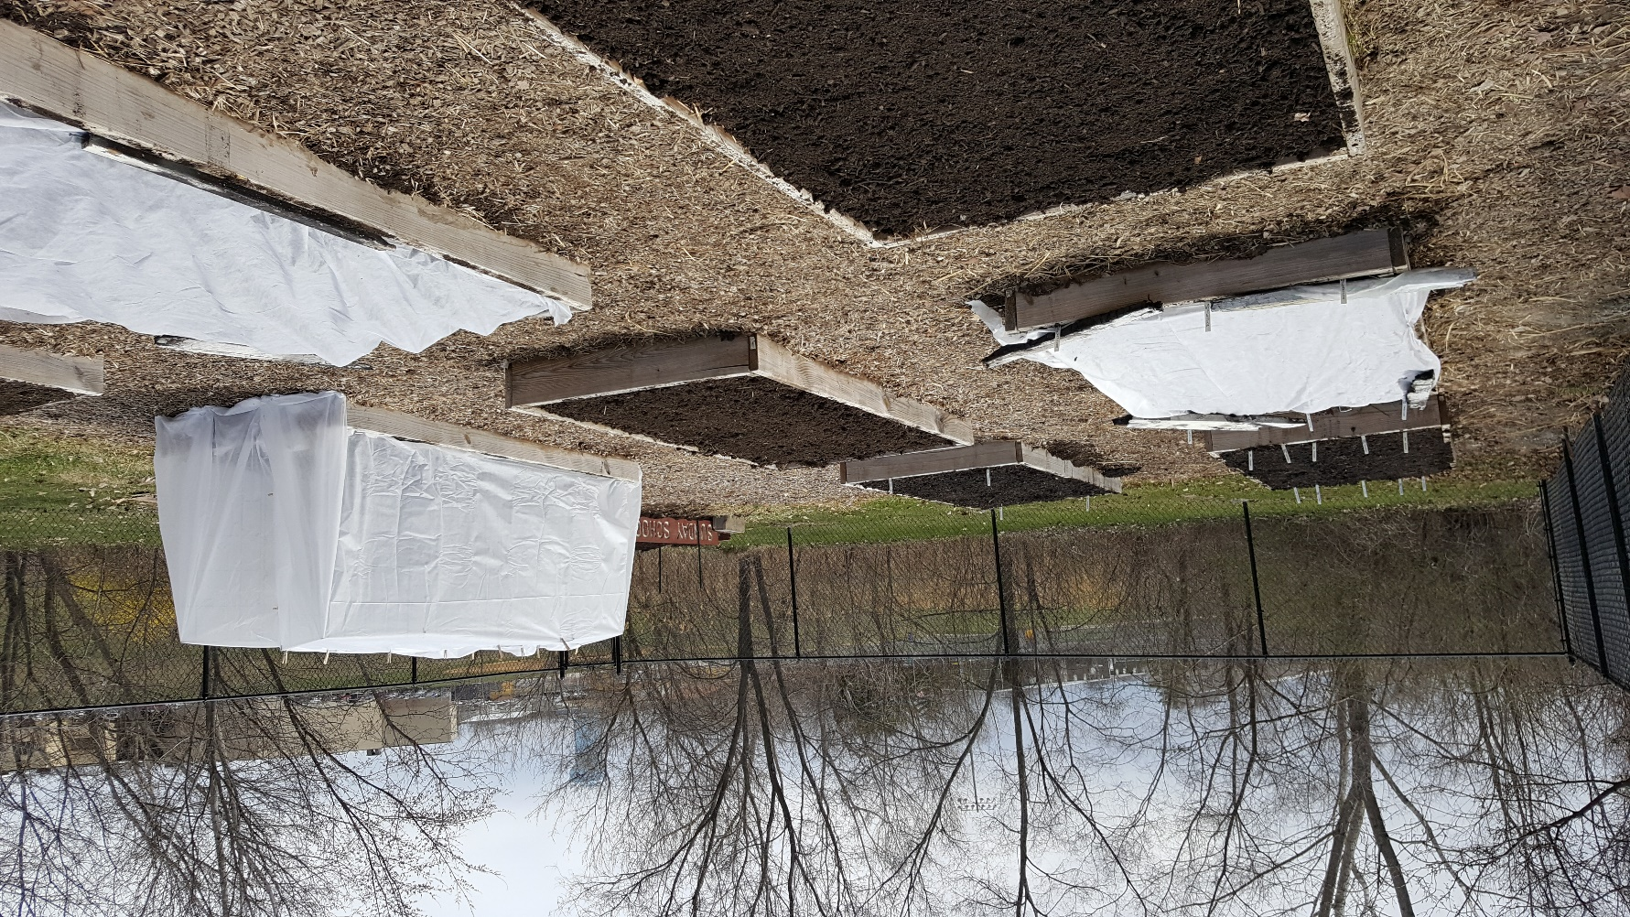
This is What B.E.S.T. $500 Investment Helped the Community!

Slide 17
Round Lake Beach Cultural and Civic Center Arts Foundation
Smilin’ Saturday Stories
Rachel Kwiecinski, Administrative Manager Improv Playhouse
Dave Kilbane, Village Administrator

Slide 18
Grant Purpose
To provide quality low cost and/or free family oriented programming. To accomplish this objective, we provided our Smilin’ Saturday Stories series where classic folk tales are brought to life by skilled storytellers.
Through these stories, we strive to achieve the goal created by the Improv Playhouse Theatre for Young Audiences Program, which is a part of Improv Playhouse’s Community Outreach and Education services. Our mission is simple:
Improv Playhouse Community Outreach and Education is committed to engaging students and enhancing communities through the performing arts. We strive to highlight the importance of imaginative thinking, giving children the opportunity to solve problems on their own volition. Our entertaining, musical shows bring well-known stories to life to teach children valuable lessons of respect, fairness, and initiative.

Slide 19
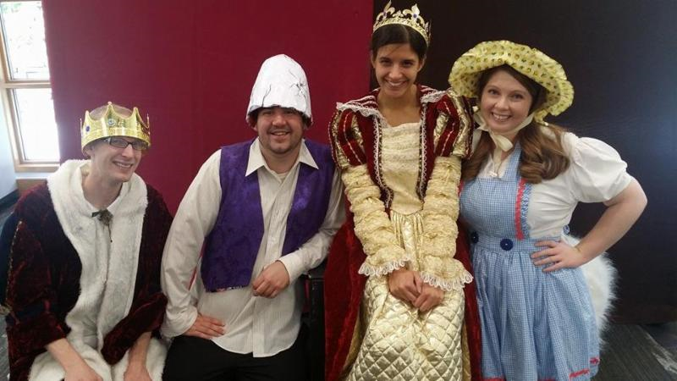
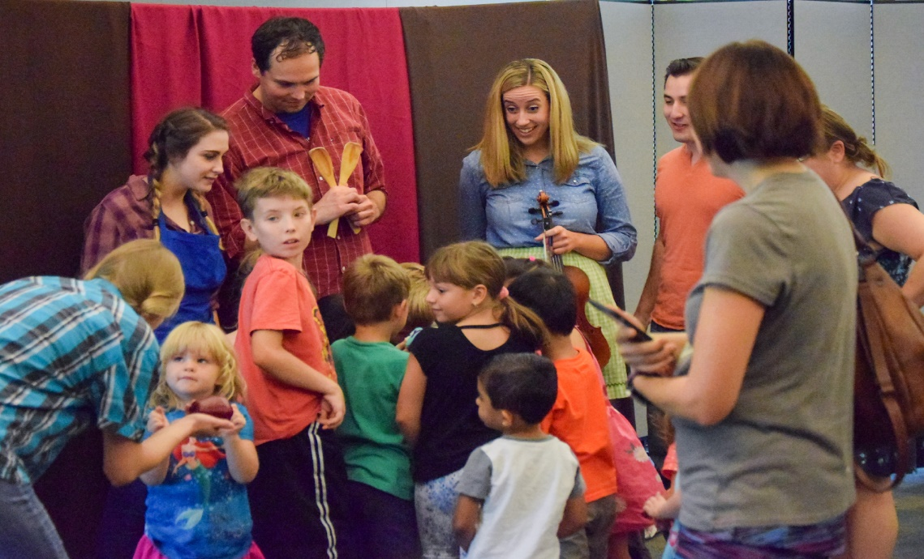
Grant Implementation
It is our goal that students learn from our shows and that they have fun doing it. We consistently receive positive response from young people and caregivers alike as they join us on our shows. We invite them to be involved and engaged during the show, even to the point of helping the actors get to the next part of the story. This hands on engaged entertainment is the perfect way for students to learn life lessons as active participants, not passive listeners.

Slide 20
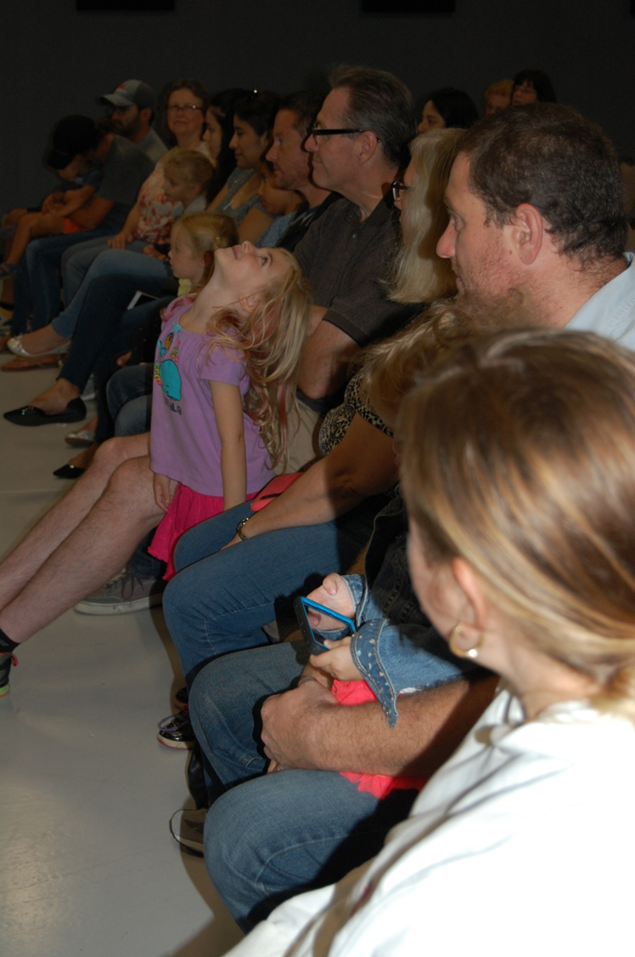
Grant Results
From our TYA director, Skylar Grieco:
These shows have been not only entertaining, but educational, providing valuable life lessons to young audiences about respect, sharing, inclusion, cooperation, and identity. It's always invigorating to engage with young people during and after the show and see how it affected them. During brief talk backs after the performances, young people offer incredible insights and observations about the show and how it relates to their own lives.
Public schools are increasingly facing challenges offering quality arts programs to their students. This means that many young people are not exposed to the arts as often, or even at all. Smilin' Saturdays provided a space for young people to gain that valuable exposure and experience art through a medium they could engage with and enjoy.

Slide 21
Round Lake Area Garden Club
Seed Swap
Carolina Schottland
Jim DiDonato

Slide 22
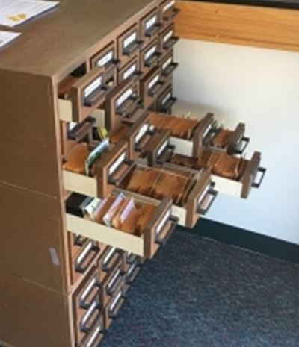
Why A Seed Library ?
Promote plant diversity, interest in horticulture, seed saving, local food production, and help residents save money
Expose people to delicious and diverse fruits and vegetable that are often more nutritious than those available at grocery stores
Educate residents about gardening and create community of seed collectors

Slide 23
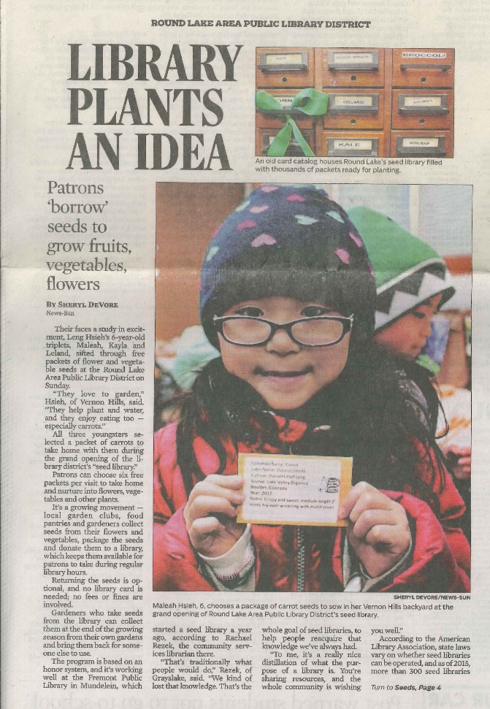
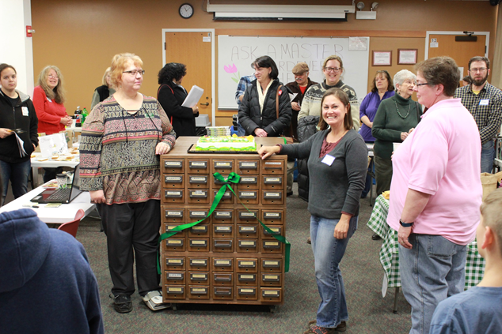
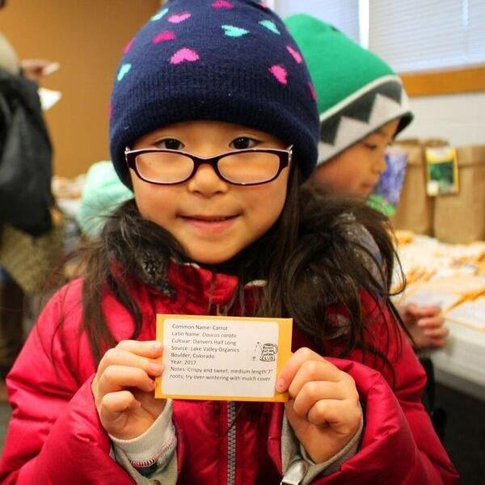
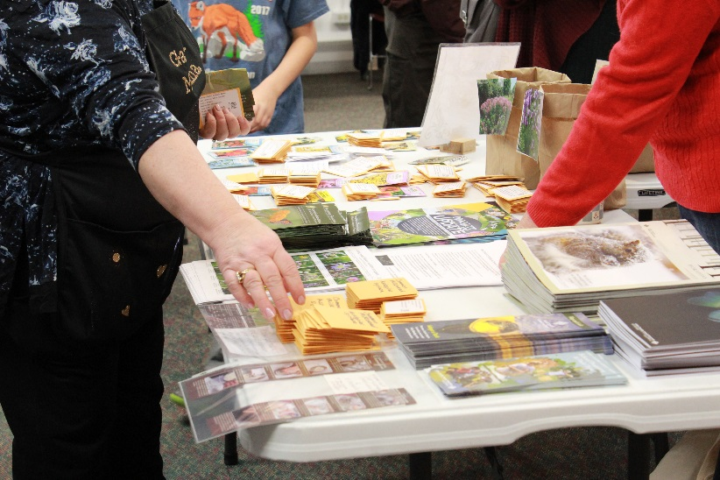
Growing Our Seed Library
With BEST’s help, we were able to acquire materials and supplies used in developing our collection.
RESULTS:
The Seed Library contains several thousand seeds, sorted and arranged by garden club volunteers.
Residents are encouraged to donate seeds collected from plants back to the Seed Library so we can provide this resource well into the future.
The library has seen increased interest in our Food Forest, monthly garden club meetings, and U of I Extension Plant Clinic as a result of our Seed Library opening.

Slide 24
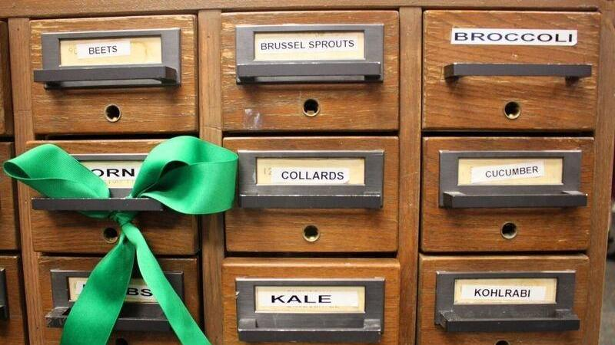
Harvesting Our Success
150 residents attended the Seed Library grand opening; several were new to gardening.
Over100 people used the Seed Library within 60 days of opening. We’ve seen increased interest with the start of spring.
We have already received seed donations from new users.
The Garden Club is encouraging users to participate in this year’s RLA Chamber of Commerce Farmer’s Market to promote gardening with food from the Seed Library.
Thank you, BEST, for helping us grow our community!

Slide 25
John T. Magee Middle School
Heroes Program
Farris Pierson, Dean of Students
Lisa Steffen, Principal

Slide 26
John T. Magee Middle School
HERO
Online positive reinforcement system
Students are rewarded for being Responsible, Respectful, and Safe
Tracks Students Tardies and Discipline
Parents and Students may login to see their students success

Slide 27
Program Initiatives
Students may “Buy” prizes from our Cougar Store each week
B.E.S.T Grant provided a multitude of prizes for students to purchase
Being Responsible, Respectful, and Safe = Positive Reinforcement
Students learn how to save for bigger and better rewards

Slide 28
School Success Thanks to B.E.S.T
Over 137,000 points given 2nd semester
Tardies
Down 46%
Out-of-School Suspensions
Down 50%

Slide 29
Round Lake Area B.E.S.T.
Bringing Everyone's Strengths Together
creating some of ”THE BEST” Lake County Has to Offer
We are proud to announce the May 2018 Grant Recipients
Round Lake High School College Ambassador Program
A Bed for Every Head – Love, Inc
Melvin Adams, Motivational Speaker – Round Lake Senior High School
#Building STEAM – Raymond Ellis Elementary School
Jazz Band Fronts – Round Lake Area Schools Music
Evolution in Real Time – Round Lake High School
Rocket Experience – Round Lake High School – Project Lead the Way

Slide 30
Round Lake Area B.E.S.T.
Bringing Everyone's Strengths Together
creating some of ”THE BEST” Lake County Has to Offer
The Mission of Round Lake Area B.E.S.T. is to be a coalition of individuals and organizations that networks and collaborates to respond to community needs, promote character-building community-wide and empower community members to positively impact the
Round Lake Area by
Bringing Everyone’s Strengths Together.

Slide 31
Round Lake Area B.E.S.T.
Bringing Everyone's Strengths Together
creating some of ”THE BEST” Lake County Has to Offer
Recognizing that youth and families today face significant challenges, Round Lake Area B.E.S.T. serves as a grassroots, multi- sector, community coalition that brings leadership from our schools,
social services, first responders, public library, park district,
each of our villages, county, state and federal elected officials,
as well as civic, business and faith leaders along side parents and students to have a collaborative conversation
about unmet needs and how to address them.

Slide 32
Round Lake Area B.E.S.T.
Bringing Everyone's Strengths Together
creating some of ”THE BEST” Lake County Has to Offer
In 2011, Round Lake Area B.E.S.T. was a recipient of a prestigious Governor’s Cup Finalist Award as part of the Governor’s Home Town Award Program in recognition of work with our
Community Empowerment Grant Committee
August of 2018 marks our 20th year of grassroots work in the
Round Lake Area
Bringing Everyone’s Strengths Together.

Slide 33
Round Lake Area B.E.S.T.
Bringing Everyone's Strengths Together
creating some of ”THE BEST” Lake County Has to Offer
Visit www.rlabest.net to learn more our work in the community via our:
Empowerment Grants Committee – Kathy Myers
Kindergarten Readiness Committee – Jeanne Kearby
Dementia Friendly Committee – Kathy Myers
Transportation Committee – Georgeann Duberstein
Find us on Facebook at RoundLakeAreaB.E.S.T.
Shop with us on smile.amazon.com

Slide 34
Round Lake Area B.E.S.T.
Bringing Everyone's Strengths Together
THANK YOU Z’s Café & Gaming for being our Breakfast Sponsor.
Z’s is your go to for quick and fresh breakfast, lunch and dinner! We feature a selection of authentic coffees, espressos, lattes, cappuccinos and more from Filicori, one of Italy’s oldest coffee roasters!
Our menu includes egg specialties, omelets, pancakes, french toast, waffles, sandwiches/wraps, burgers, salads and more- something for everyone! We also offer a selection of beer and wine.
Adults 21 and older can relax in Z’s gaming room. Please MENTION RLA BEST when you visit!
Z’s Café & Gaming 435 N. Wilson Road * Round Lake, Illinois 60073
Between Route 134 (Big Hollow Rd) and Nippersink Road

Slide 35
Round Lake Area B.E.S.T.
Bringing Everyone's Strengths Together
WE ARE PLEASE TO ANNOUNCE THAT WE ARE UPGRADING WITH A SMALL BUT OH SO HANDY TWEAK
HOW WE ANNOUNCE EVENTS!!
We will begin sending B.E.S.T. meeting and events with an “add to calendar” option for your planning ease.

Slide 36
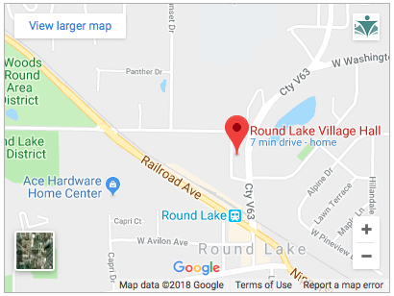
Round Lake Area B.E.S.T.
Bringing Everyone's Strengths Together
IS M O V I N G our Monthly Membership Meeting.
June 14th at 8:30am The Annex at Round Lake Village Hall
442 N. Cedar Lake Road
Round Lake, IL. 60073
Village Hall is on Cedar Lake Road between
Hart Road and 134
(between the Metra Station and Magee Middle School)
Enter from the rear parking lot then go left to the meeting room.
​Everyone is invited!!

Slide 37
Round Lake Area B.E.S.T.
Bringing Everyone's Strengths Together
creating some of ”THE BEST” Lake County Has to Offer
And now little exercise!!
Everyone take a deep breath,
stretch your arms above your head,
Now exhale as you reach under your chair
to see what you find!

Slide 38
Round Lake Area B.E.S.T.
Bringing Everyone's Strengths Together
creating some of ”THE BEST” Lake County Has to Offer
If you find a little note please take a moment to absorb the message and then choose a plant to take with you as you leave today!
If you did not find a note, know we appreciate you and all you are doing in creating some of ”THE BEST” Lake County has to offer!

Slide 39
Round Lake Area B.E.S.T.
Bringing Everyone's Strengths Together
creating some of ”THE BEST” Lake County Has to Offer
Thank you for attending today!
See you at our next meeting –
June 14th 8:30am
At our NEW LOCATION The Annex at Round Lake Village Hall!!

Slide 40
Round Lake Area B.E.S.T.
Bringing Everyone's Strengths Together
IS M O V I N G our Monthly Membership Meeting.
June 14th at 8:30am The Annex at Round Lake Village Hall
442 N. Cedar Lake Road
Round Lake, IL. 60073
Village Hall is on Cedar Lake Road between
Hart Road and 134
(between the Metra Station and Magee Middle School)
Enter from the rear parking lot then go left to the meeting room.
​Everyone is invited!!

